Slide 2
BGP FlowSpec in 2019: operational experience and future developments
a.k.a. “yet another FlowSpec talk”
Alessandro Bulletti
Kirill Kasavchenko

Slide 3
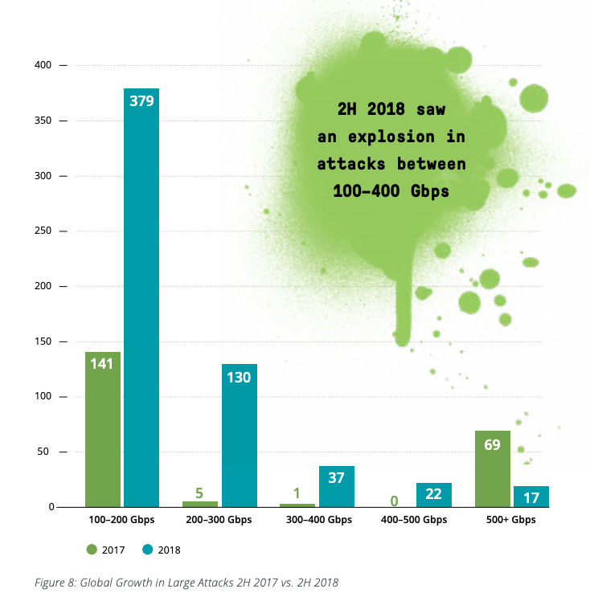
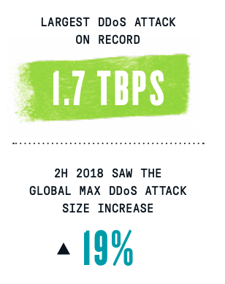
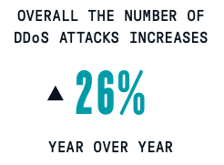
Volumetric DDoS attacks 2018-2019
Source: Rapporto Clusit 2019 sulla Sicurezza ICT in Italia - Tipologie di attacchi DDoS (Dati Fastweb relativi all’anno 2018)
Source: Netscout Threat Report 2018

Slide 4
The need for collaboration
Ideally, large DDoS attacks should be mitigated as close to the source as possible.
Practically, the good first step would be:
Customer asks upstream provider to mitigate
Peer asks another peers
As time goes by and trust is built, we might expect mitigation to naturally propagate closer to the source.

Slide 5
Wait... This is not a new idea!
Some of initiatives in this area:
Fingerprint Sharing Alliance (Arbor, 2005)
BGP FlowSpec (IETF, 2009)
M3AAWG DDoS Info Sharing (2017)
I2NSF (IETF, 2017)
Stellar: advanced blackholing (DE-CIX/TU Berlin/Max Planck Institute, 2018)
DOTS (IETF, work in progress)

Slide 6
Wait... This is not a new idea!
Some of initiatives in this area:
Fingerprint Sharing Alliance (Arbor, 2005)
BGP FlowSpec (IETF, 2009)
M3AAWG DDoS Info Sharing (2017)
I2NSF (IETF, 2017)
Stellar: advanced blackholing (DE-CIX/TU Berlin/Max Planck Institute, 2018)
DOTS (IETF, work in progress)
Vendor support
Open-source tools
Operational experience
User groups

Slide 7
FlowSpec: vendors and open-source
Controllers and BGP FlowSpec speakers:
Arbor (Netscout)
ExaBGP
FastNetMon
Nokia
Radware
Routers:
Cisco IOS-XR (ASR9K, NCS5K) and IOS-XE
Juniper MX/PTX
Alcatel/Nokia 7x50
Huawei NE routers
6WIND
Arista
Telemetry
FlowSpec

Slide 8
FlowSpec: operational experience & user groups
Deployments (based on public information):
Cloudflare, Level3, Rostelecom, Orange Poland
DDoS Peering initiative:
AT&T, Century Link, Charter
See slides at NANOG 71 and 75 (links in the end of this presentation)
FlowSpec multi vendor tests by T-Mobile Austria and NextLayer :
Cisco, Juniper, Huawei, Nokia
Focus on Inter-AS applicability and operational needs

Slide 9
What works well
FlowSpec is extensively used against DDoS Amplification attacks:
We see operational community is automating FlowSpec generation to stop attacks without human involvement:
Not just hyperscalers
We see adoption of FlowSpec as the way to redirect traffic on demand:
Redirect to Route Target
Redirect to Next-Hop

Slide 10
What could be improved
Scale on router side:
Number of concurrently supported FlowSpec rules
Speed of FlowSpec rules import and processing
Various „safety nets“:
Prevent too many FlowSpec rules from impacting router forwarding performance
Lack of granularity in import policies:
It is impossible to allow/reject FlowSpec rules based on action
Therefore, possible for customer to change DSCP of their traffic to „network-critical“
These are implementation-specific improvements. They do not require industry consensus in a form of IETF document or BCP.

Slide 11
What is impossible to do with FlowSpec today
Match traffic based on random L3-L4 field or based on payload
Example: IP TTL, TCP Window Size
Report traffic statistics across administrative boundaries
ISP1 sends a FlowSpec rule to ISP2
How ISP1 gets visibility into dropped traffic to estimate the efficacy of FlowSpec?
There is a lack of common approach to these problems.
We need standards (think RFC documents) or some well-defined Best Current Practices

Slide 12
Flexible Payload Matching: problem statement
Majority of volumetric DDoS attacks are amplification attacks. They can be successfully mitigated using „standard“ FlowSpec, matching source UDP port:
However, there exist more complex cases:
Bittorent amplification
SSDP diffraction
These attacks result in packets with random source UDP port, so it‘s not possible to create a classifier using FlowSpec.
At the same time, these attacks generate specific patterns in payload.
And some routers are able to match packets based on payload.

Slide 13
Flexible Payload Matching: solution (1/2)
draft-khare-idr-bgp-flowspec-payload-match
Extend FlowSpec with „flexible match conditions“ component type:
Type X – Flexible Match Conditions

Slide 14
Flexible Payload Matching: solution (2/2)
draft-khare-idr-bgp-flowspec-payload-match
Use new component type to match anywhere in the packet:
In any field
Across fields regardless of field boundaries
In payload
Match using:
Bit pattern with bitmask
Numeric pattern
Regular expressions

Slide 15
FlowSpec and Reporting: problem statement
How do you know if FlowSpec rule is effective?
No standardized way to report traffic that matches FlowSpec policy:
SNMP counters
XML/Netconf
draft-wu-idr-flowspec-yang-cfg-02
Good news: most routers generate flow telemetry for traffic, dropped by FlowSpec:

Slide 16
FlowSpec and Reporting: solution
Corellate FlowSpec NLRI and Flow records:
Vendor-independent approach
No need to parse proprietary SNMP or XML data models
Flow Record
Src IP
Dest IP
Src Port
Dst Port
Proto
Input Intf
Output Intf = 0
ToS
Flags
Dest Prefix
Source Prefix
IP Protocol
Port
Dst Port
Src Port
ICMP type
ICMP code
TCP flags
Packet length
Etc…
FlowSpec NLRI

Slide 17
FlowSpec and Reporting: Inter-AS?
Reporting based on Netflow and FlowSpec correlation won‘t work between ASNs
No way for ISP1 to receive flow telemetry from ISP2
Other approaches (SNMP, Netconf, streaming telemetry) won‘t work either
We would need something totally new:
Most likely some mediation tool that makes sure only relevant information is reported between ASNs
Or some concept of „administrative domains“ in flow / SNMP / streaming telemetry
Whatever the solution would be, having visibility into FlowSpec rules propagated between ASNs is going to be an essential factor for adoption

Slide 18
FlowSpec evolution: RFC5575bis
Major changes
Defines all traffic action extended communities as transitive extended communities. RFC5575 defined the traffic- rate action to be non-transitive and did not define the transitivity of the other action communities at all.
Introduces a new traffic filtering action traffic-rate-packets:
Instead of ”rate-limit to 100 bps” you can now “rate-limit to 100 pps”
Introduces rules how updates of Flow Specifications shall be handled in case they contain interfering actions
A full list of changes can be found in the references section of this slide deck

Slide 19
Other interesting FlowSpec developments
FlowSpec interface set (draft-ietf-idr-flowspec-interfaceset)
Use BGP communities to signal to which interfaces (interface-set) should a FlowSpec action be applied
Supported in Cisco IOS-XE

Slide 20
Summary
A.k.a Last Slide
FlowSpec is a mature DDoS mitigation technology
No, it‘s not perfect and alone is not enough to stop all types of DDoS attacks
it is not applicable against TCP SYN floods and application layer DDoS
but it mitigates the most impacting DDoS types in ISP networks – amplification attacks
Check with $your_router_vendor what the platform limits are:
Scale
Policies
Don‘t be afraid to automate FlowSpec. If you don‘t know how – talk to us.
Work with IETF and vendors to get new FlowSpec ideas implemented

Slide 21
References
The last slide, really
Stellar, advanced blackholing: https://www.de-cix.net/Files/2731074c857497be3827ac9537b6e486f27aa57c/Research-paper-Stellar-Network-Attack-Mitigation-using-Advanced-Blackholing.pdf
NANOG71 DDoS peering: https://www.youtube.com/watch?v=Aj8EKYVSTtk
NANOG75 eBGP FlowSpec peering: https://www.youtube.com/watch?v=rKEz8mXcC7o
Interop FlowSpec tests by T-Mobile and Next Layer: https://www.nextlayer.at/wp-content/uploads/2018/06/loibl-bacher-bgp-flowspec-interop-012017.pdf
FlowSpec payload matching: https://datatracker.ietf.org/doc/draft-khare-idr-bgp-flowspec-payload-match/
SSDP Diffraction Attack: https://www.netscout.com/blog/asert/new-twist-ssdp-attacks
FlowSpec at CloudFlare: https://meetings.ripe.net/see4/files/RIPE%20SEE4%20Belgrade%20Serbia%20-%20CloudFlare%20-%20DDoS%20mitigation%20-%20Martin%20Levy.pdf
FlowSpec at Level3: https://www.capacitymedia.com/articles/3585228/Level-3-launches-BGP-Flowspec-on-global-backbone
FlowSpec at Rostelecom: https://habr.com/ru/company/rostelecom/blog/325138/
FlowSpec in Orange Poland: https://cert.orange.pl/aktualnosci/ddos-w-naszej-sieci-coraz-silniej-coraz-wiecej
RFC5575bis changes compared to RFC5575: https://tools.ietf.org/html/draft-ietf-idr-rfc5575bis-14#appendix-A

Slide 22
alessandro.bulletti@netscout.com
kirill.kasavchenko@netscout.com

